Slide 1

Biological Signals Analysis- 2024A
Project number 6- Pablo: Calcium Segmentation
Dekel David, Ziv Bentulila

Slide 2
Goals
﻿The project aims to detect neurons in a time-lapse recording from a mouse’s visual cortex.
﻿Main goal: Write a script that can automatically detect the cells in the FOV, record their calcium activity and compare your results to the ground truth.

Slide 3
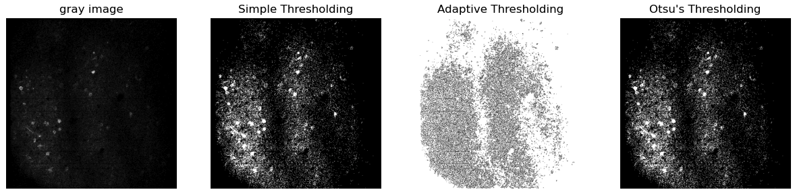
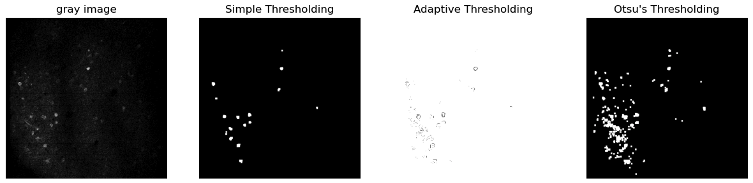
Noise reduction and Thresholding
Thresholding with no noise reduction:
Applying both thresholding and noise reduction using morphological opening:

Slide 4
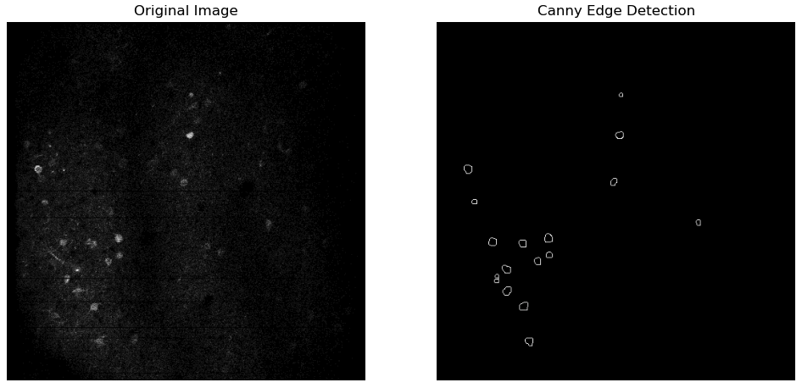
Edge Detection
However, we found that is wasn’t necessary for segmentation process in this case

Slide 5
Contour Based Segmentation
A contour is a curve joining continuous points along the boundary of an object in the image. Contours offer advantages over methods that rely solely on geometric shapes like circles for recognizing cells, especially when cells do not have a perfect circular shape. This method can accurately identify and delineate cells, even when they deviate from a perfect circular shape

Slide 6
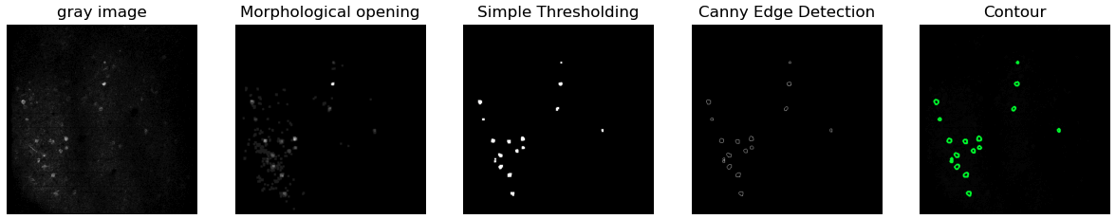
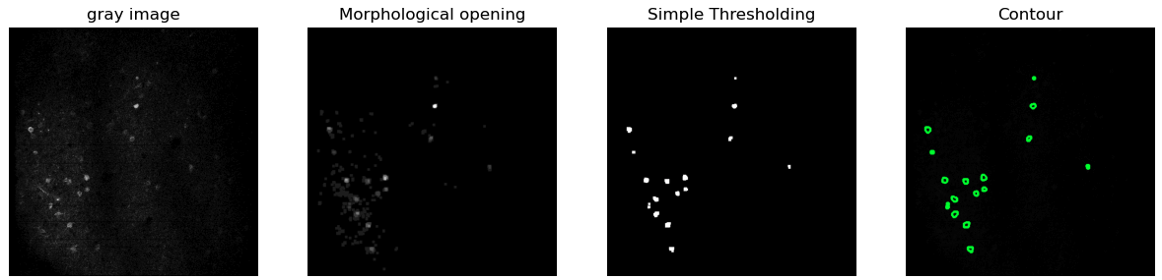
Contour Based Segmentation
With edge detection:
Without edge detection:

Slide 7
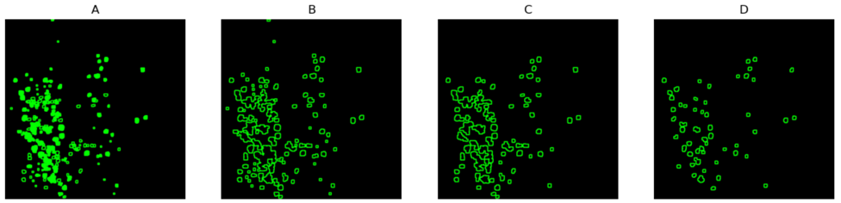
Combined Segmentation Pattern
Removing intersections
Filtering contours based on minimum area
Adding an upper limit

Slide 8
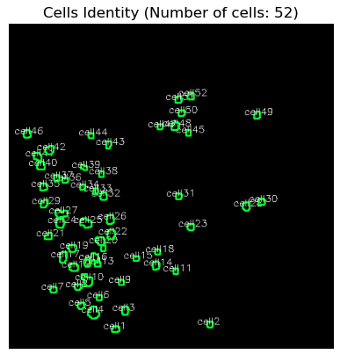
Cell Identification

Slide 9
Improvements
We can increase the number of detected cells by experimenting with various parameters in the code, such as the minimum and maximum contour area or the parameters od the simple thresholding, but it comes at the expense of distinguishing between cells (often resulting in multiple cells being considered as one).

Slide 10
CaImAn Python Library
We encountered a paper that improved the detectability of calcium imaging experiments. It was accompanied by a Python library, rich documentation, and examples that helped implement it in other data. This Python library, CaImAn, is specifically designed to analyze one-photon and two-photon calcium imaging data.

Slide 11
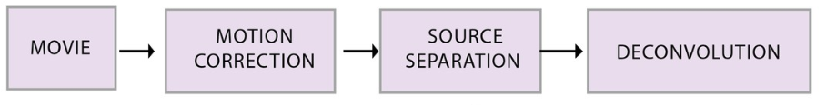
CaImAn – Main pipeline

Slide 12
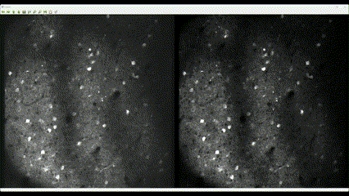
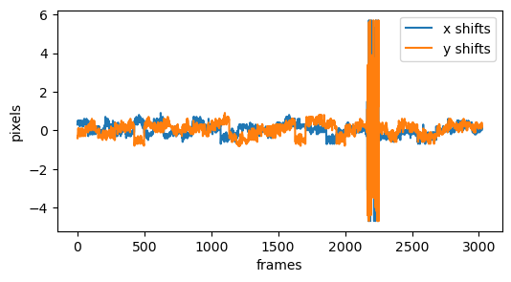
CaImAn – Motion Correction

Slide 13
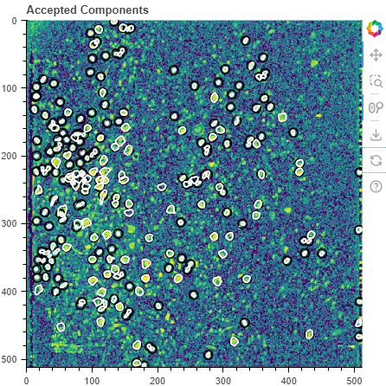
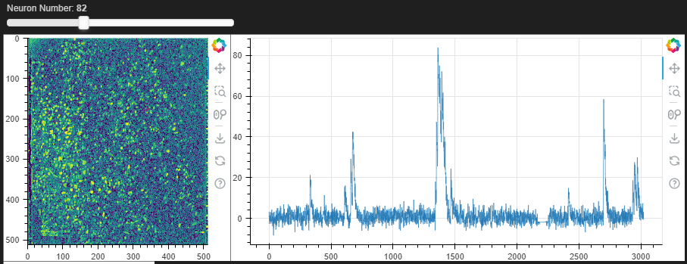
CaImAn – Source Separation

Slide 14
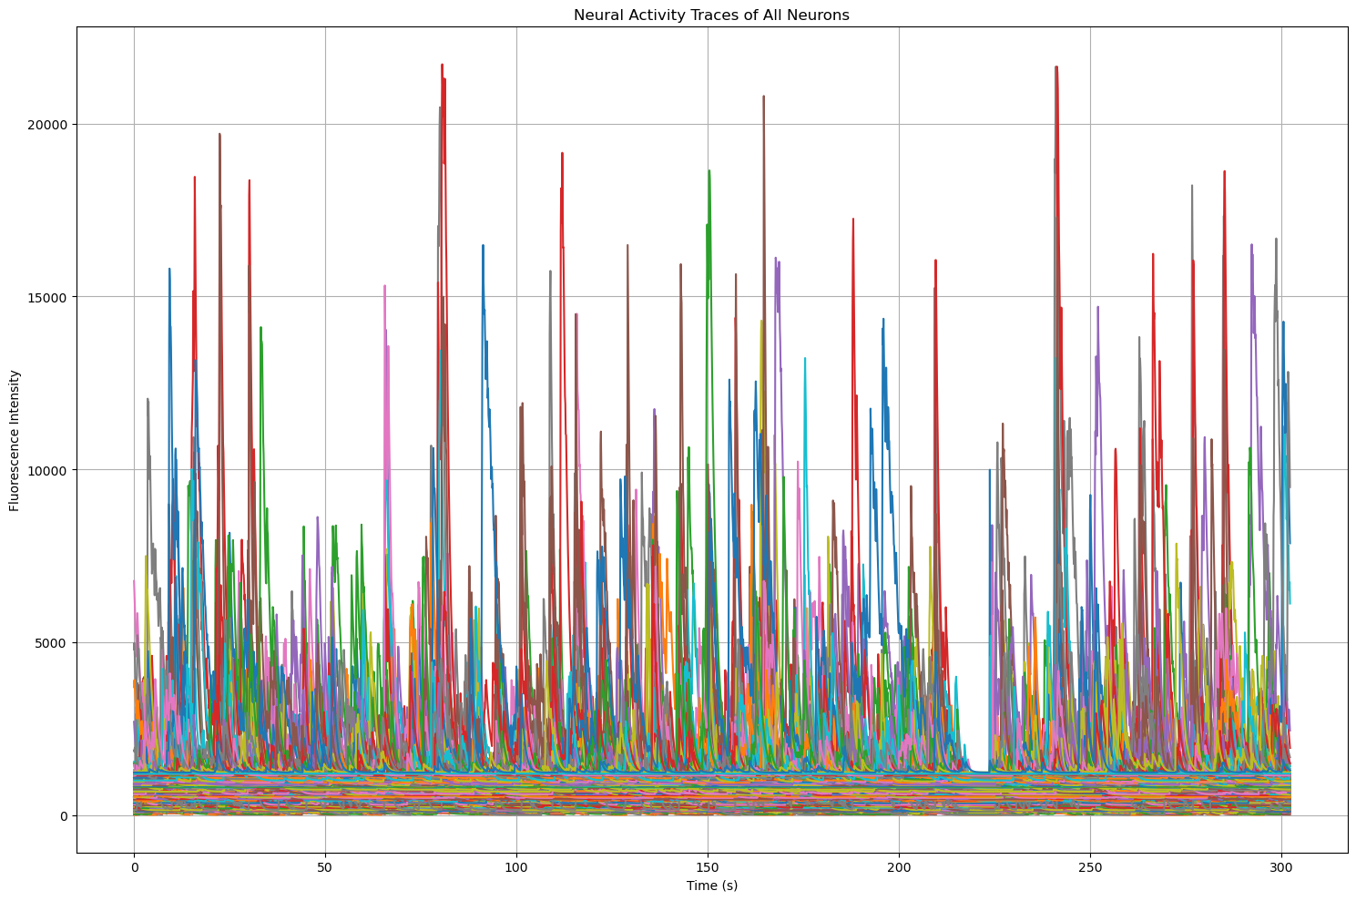
CaImAn – Overall activity of FOV neurons

Slide 15
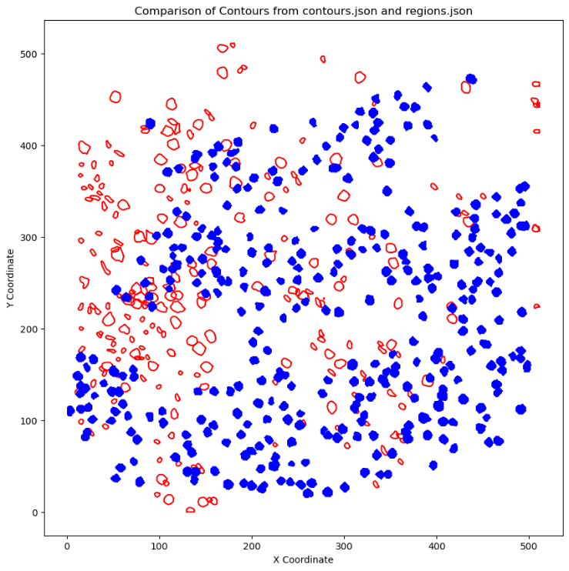
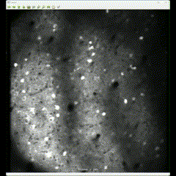
CaImAn – Comparison to regions.json

